Slide 1

Art exhibitions
Axèle Mahalin
June 9th, 2023

Slide 2
Agenda
Project context
Planning
Data collection
Data cleaning
Entity Relationship Diagram
Exploratory data analysis
Data visualization
Main results
Machine learning
Demo
Challenges
Highlights
Conclusion

Slide 3
Project context
Far from being a "non-essential" activity, contact with art is, on the contrary, essential to our well-being
Navigating the vast art world can be overwhelming, with countless exhibitions taking place simultaneously in different locations
Simplify the way art enthusiasts discover exhibitions by providing a personalized art exhibitions recommender in Paris
“Art is a line around your thoughts.”
― Gustav Klimt
Notes:
November 2019, the World Health Organization report

Slide 4
Planning
Project plan
Data cleaning
Data analysis
Data collection
MySQL
Machine Learning

Slide 5



Data collection
Data.iledefrance.fr - French museums: 134 rows, 15 columns
Data.culture.gouv.fr - French museums visitors: 23587 rows, 13 columns
Opendata.paris.fr - Exhibitions in Paris: 2039 rows, 42 columns

Slide 6
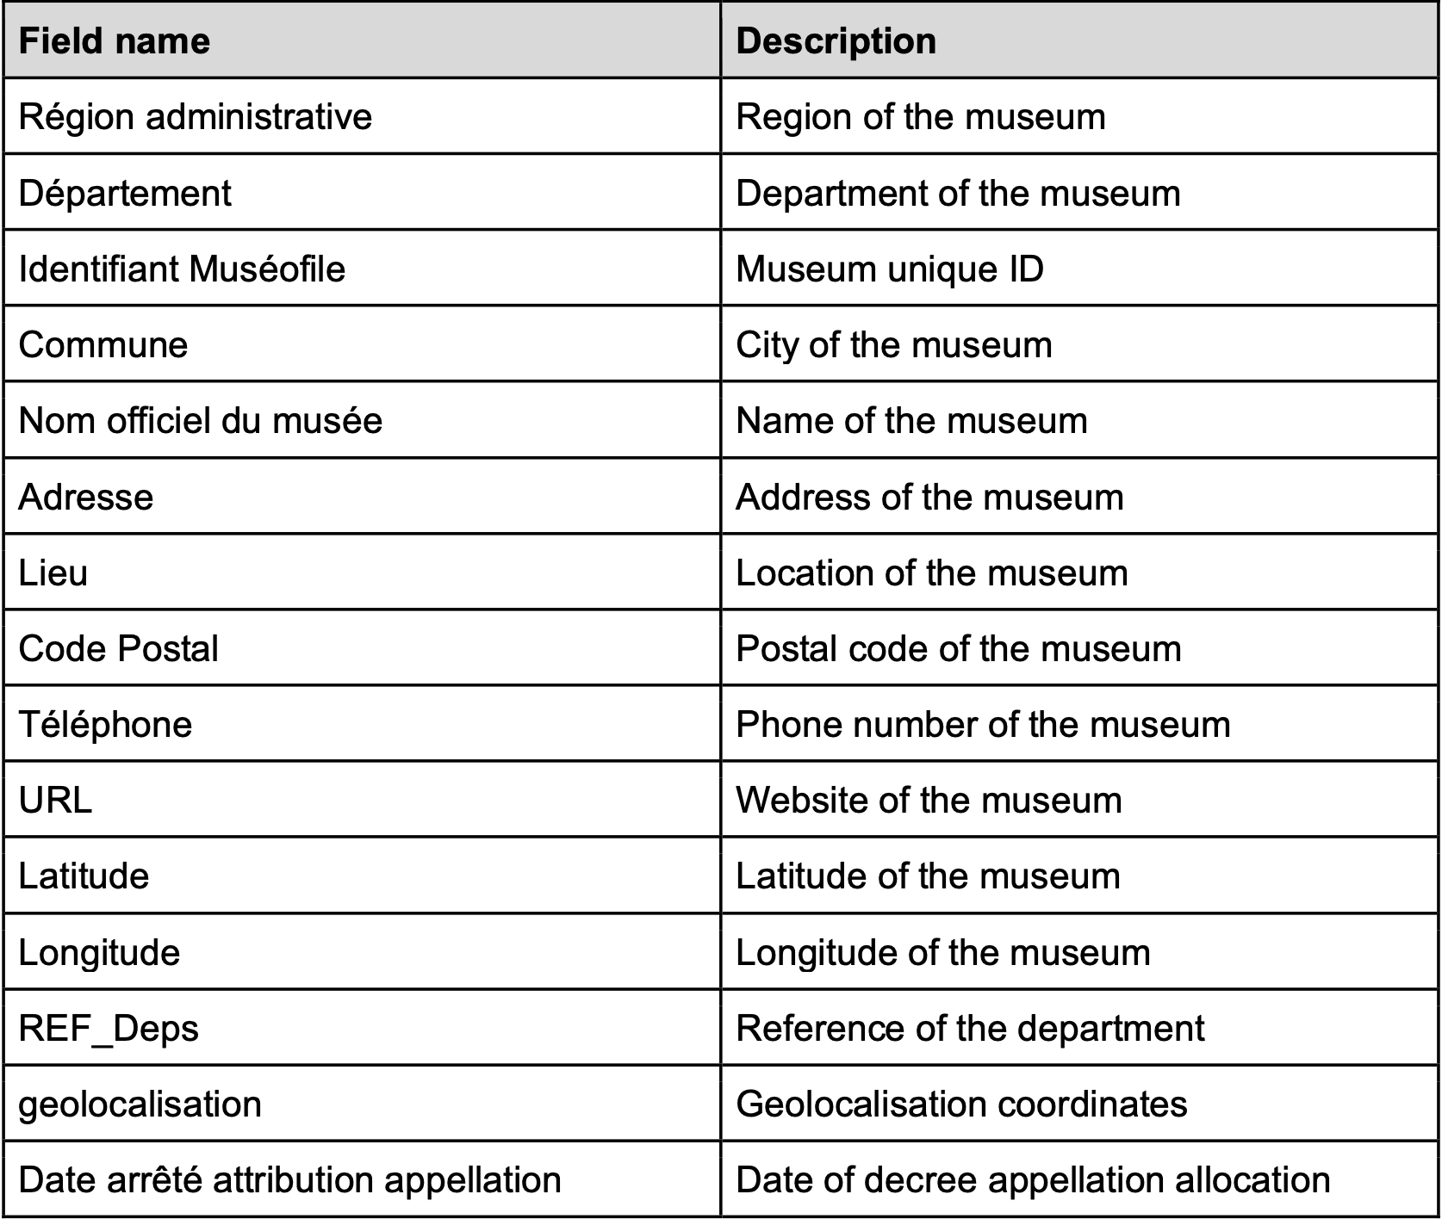
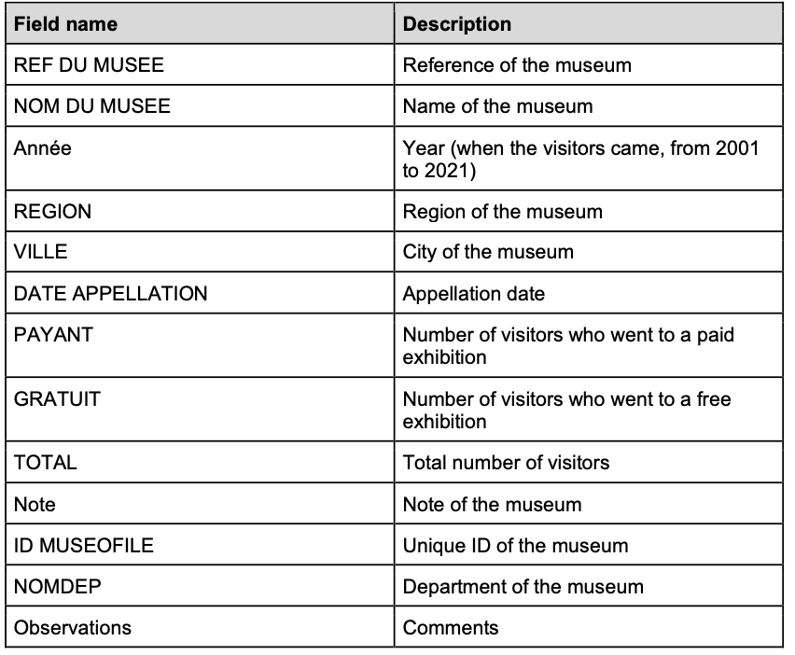
French museums
French museums visitors

Slide 7
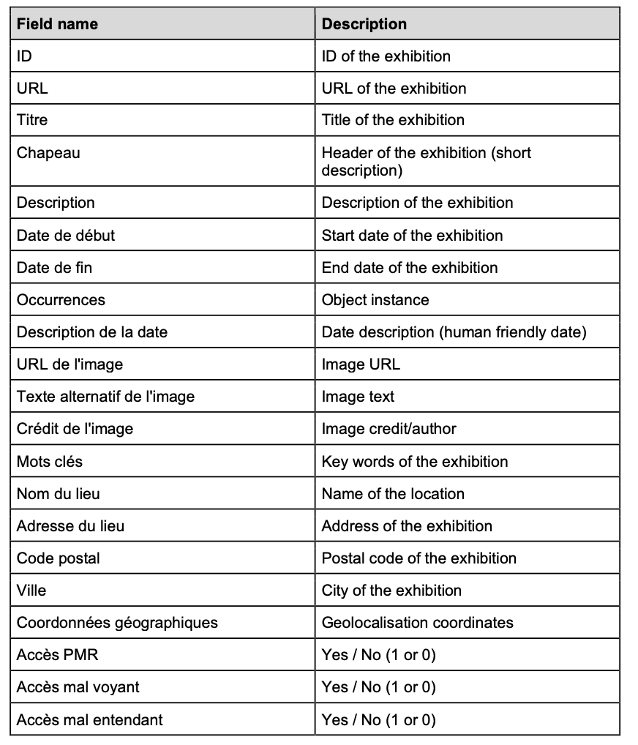
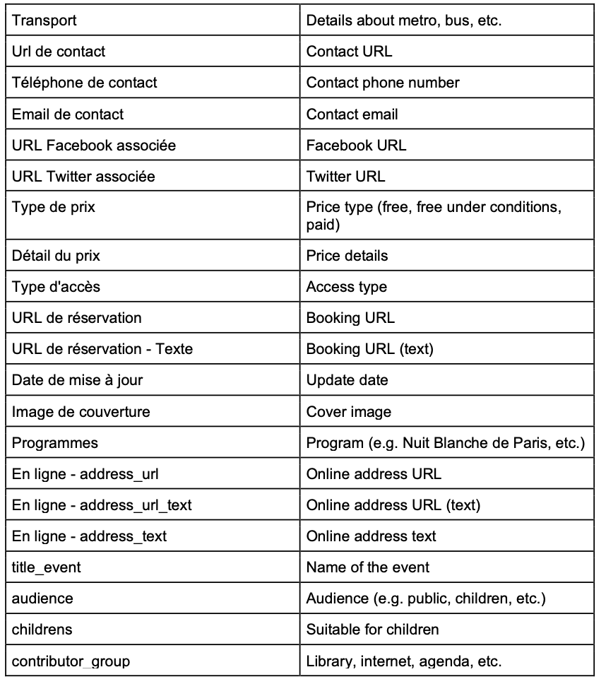
Exhibitions in Paris

Slide 8
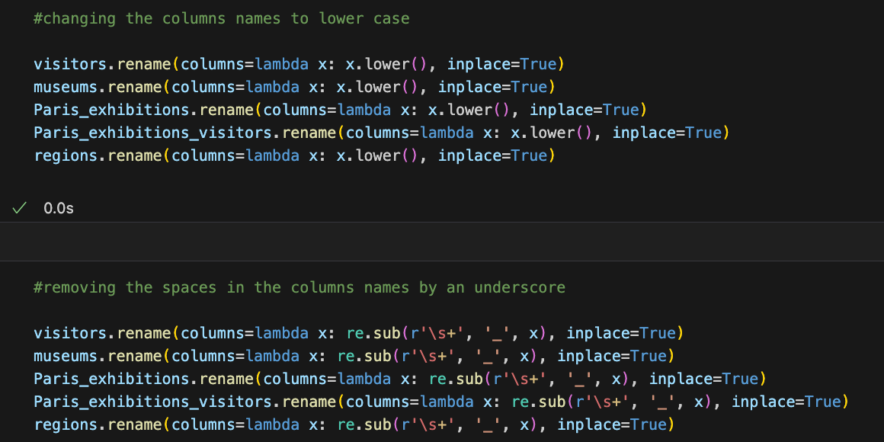
Data cleaning
Method applied to the 3 datasets:
Data wrong types
NaN values
Duplicates
Corrupted rows
Unnecessary columns
Columns renaming

Slide 9
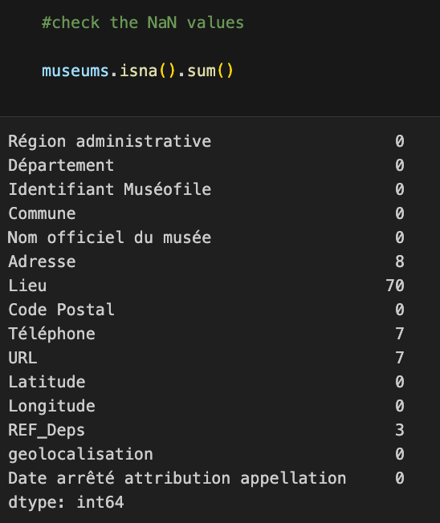
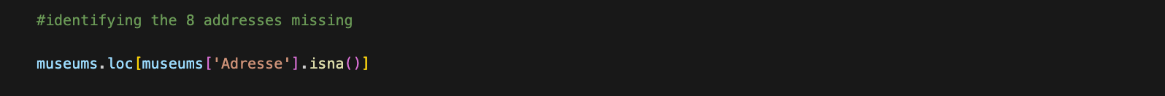
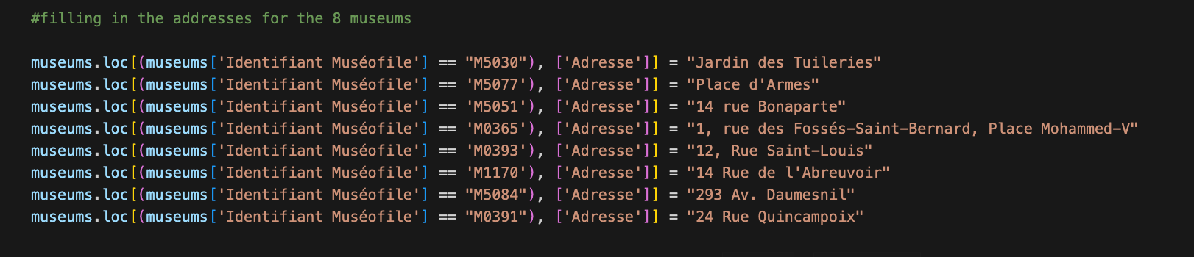
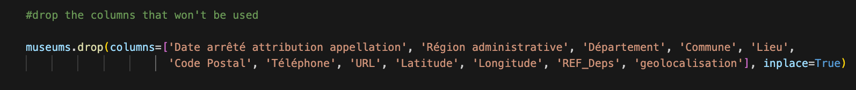
French museums
Handling missing values
Drop columns
Notes:
134 rows in total

Slide 10
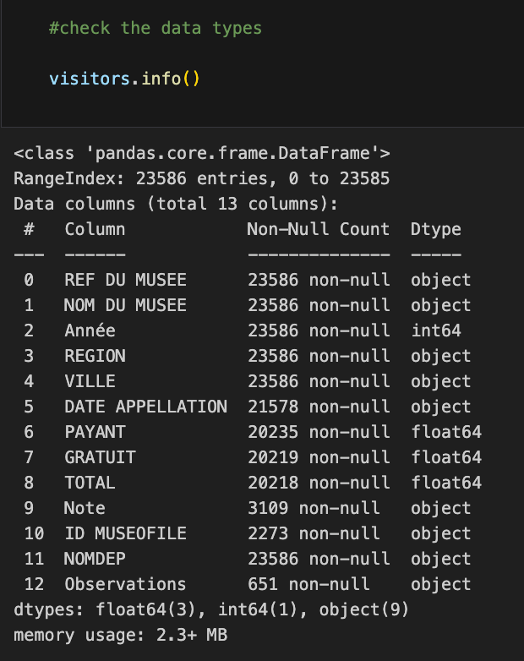
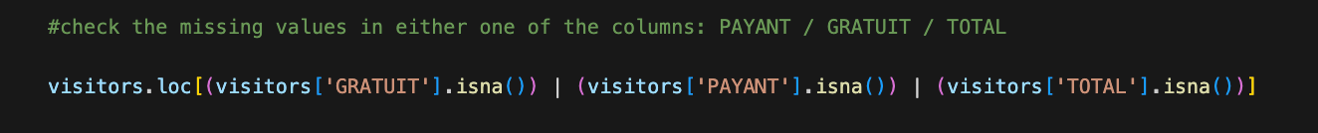
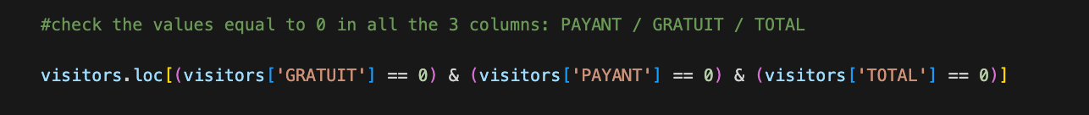

French museums visitors
Handling 0 and missing values
→ Dropped them since they represented 3380 rows over 23586
Convert data types

Slide 11
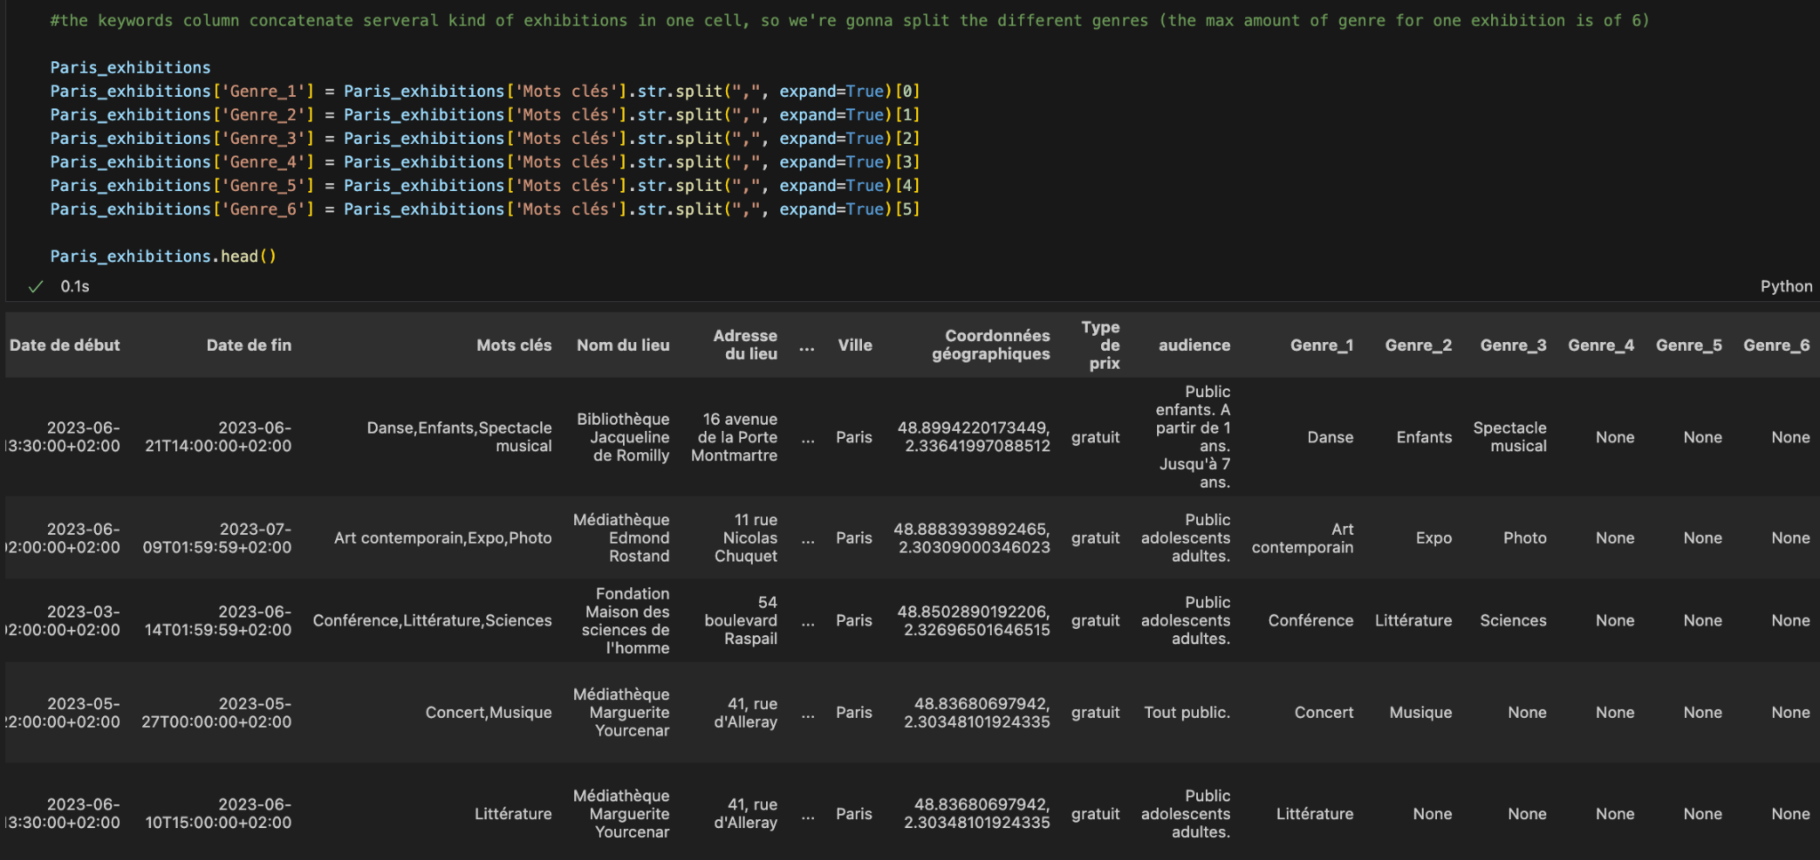
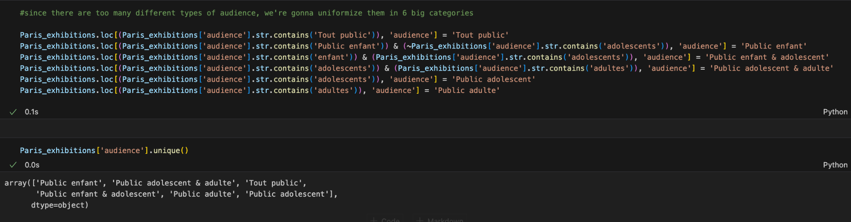
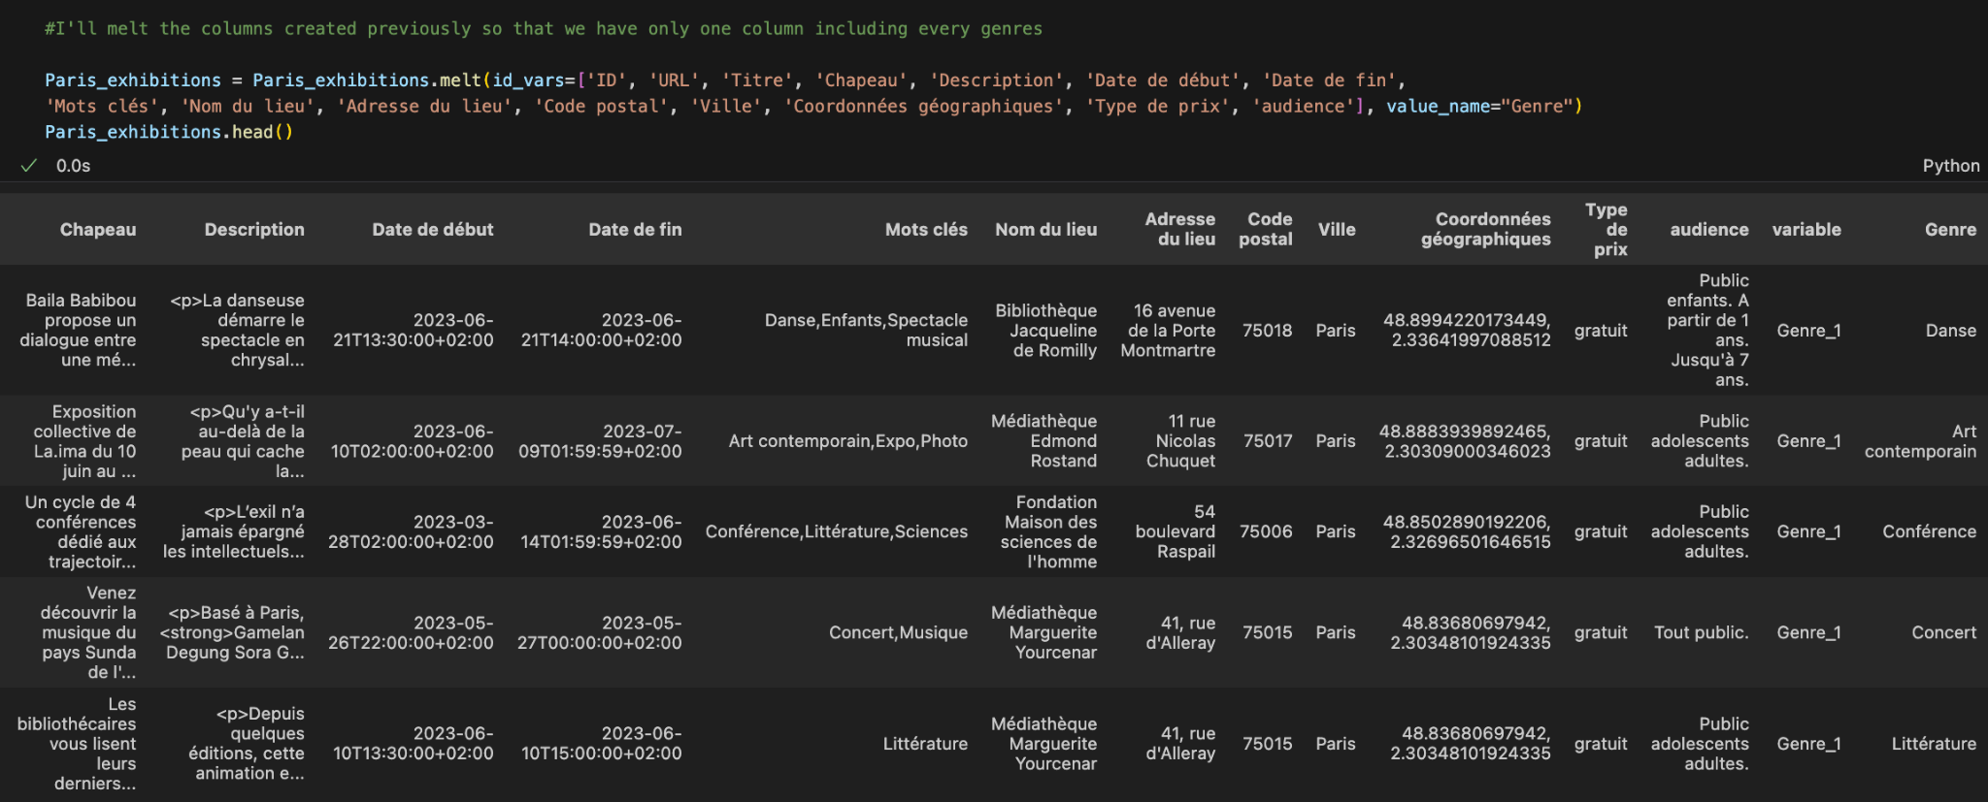
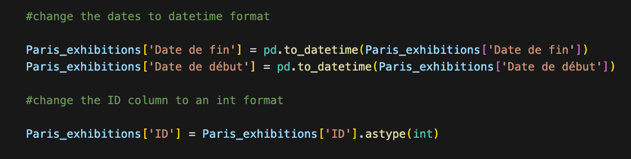

Exhibitions in Paris
Keywords cleaning
Audience cleaning
Duration column
Convert data types
Convert data types
Notes:
156 types of audience at the beginning

Slide 12
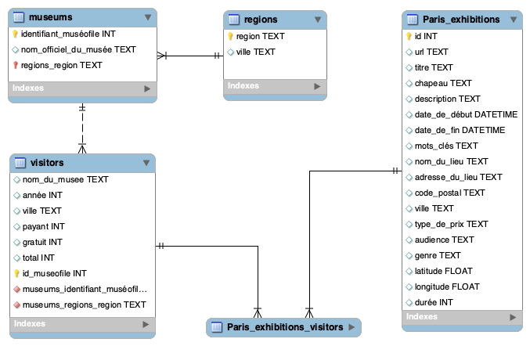
ERD
Notes:
Pymysql library

Slide 13
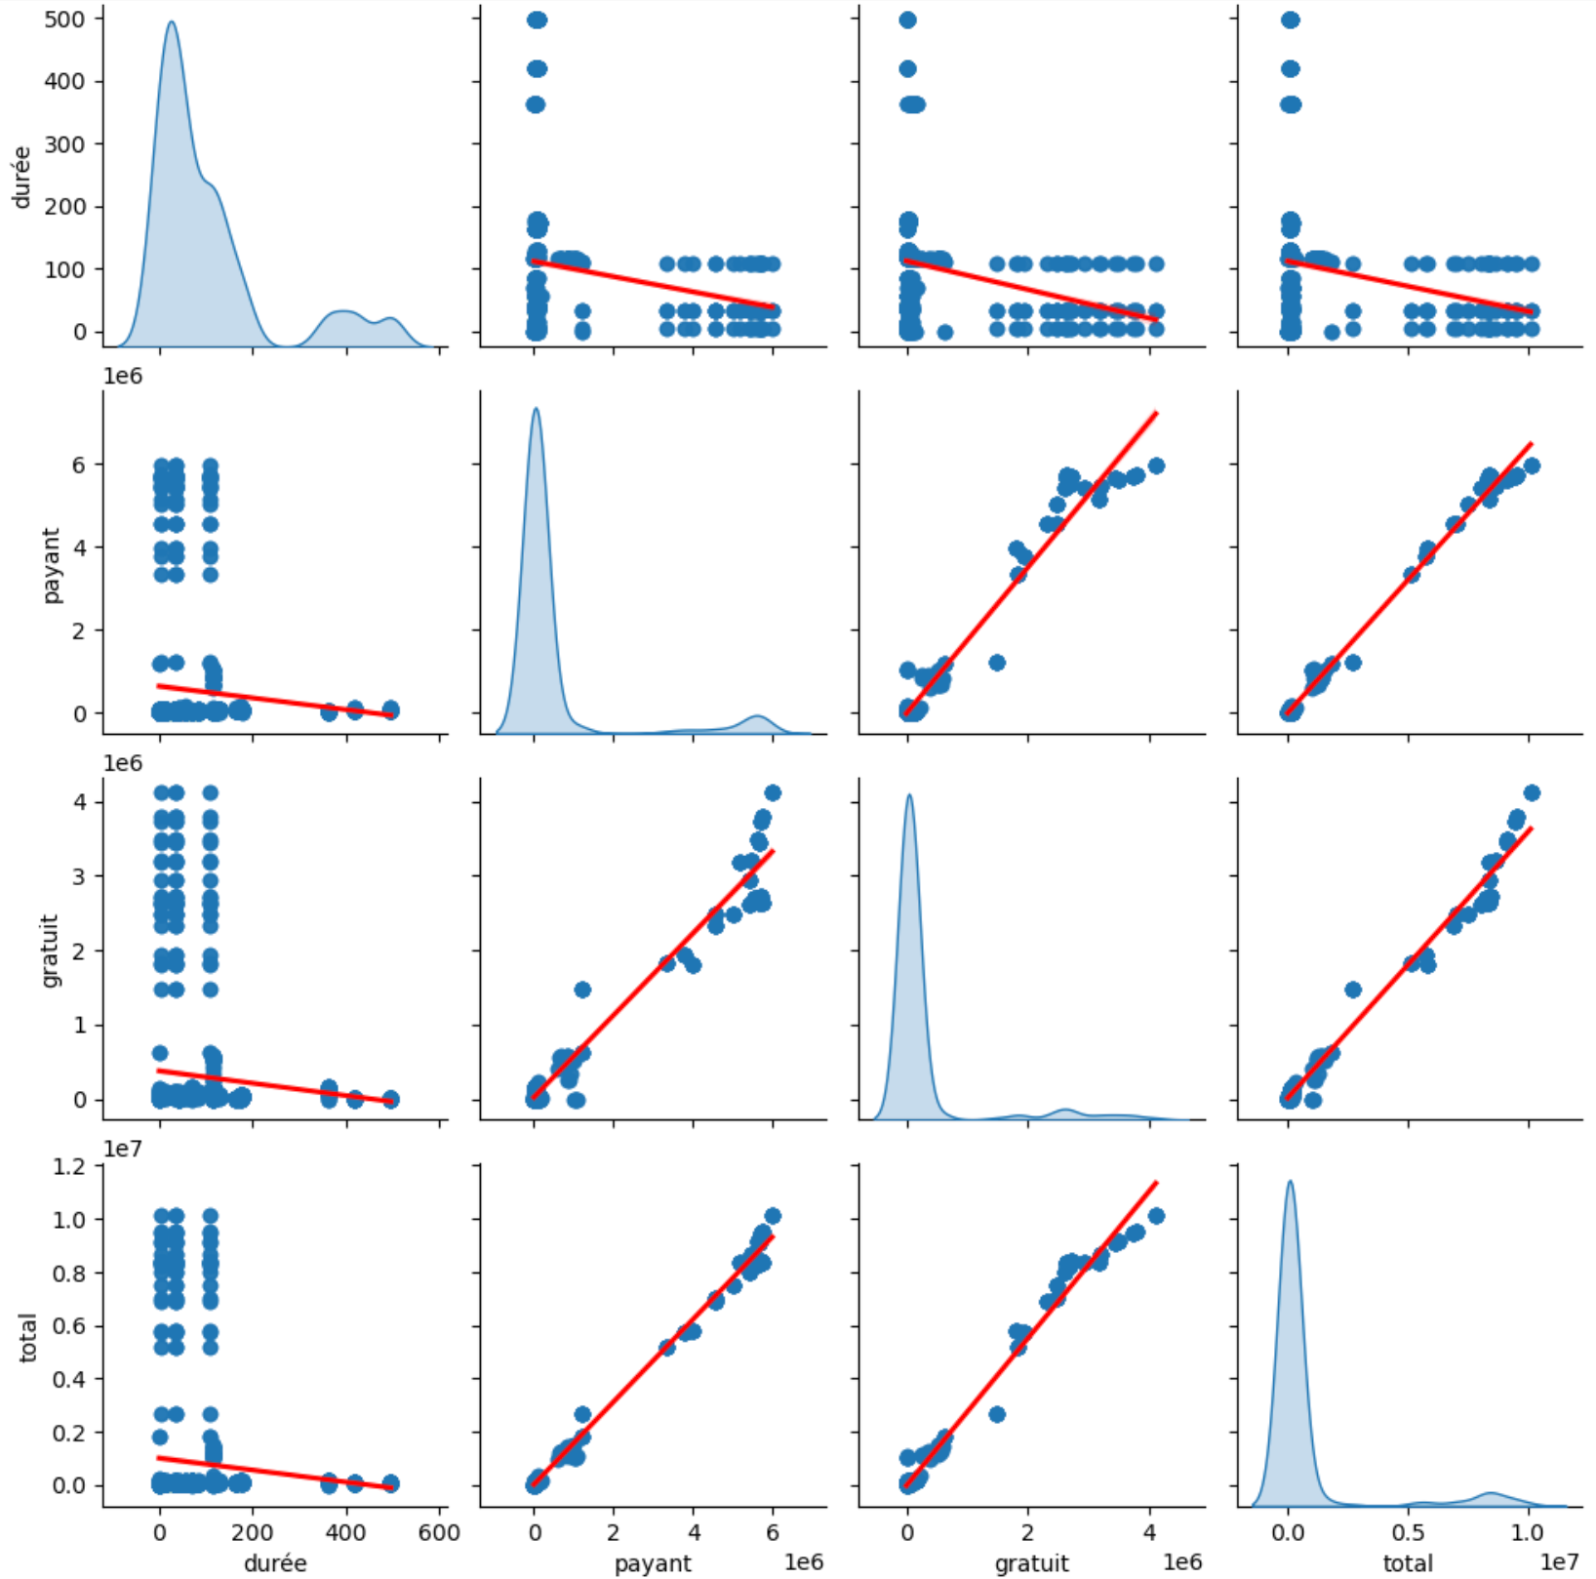
Exploratory data analysis
Exhibition’s duration and number of visitors correlation
Pairwise relationship

Slide 14
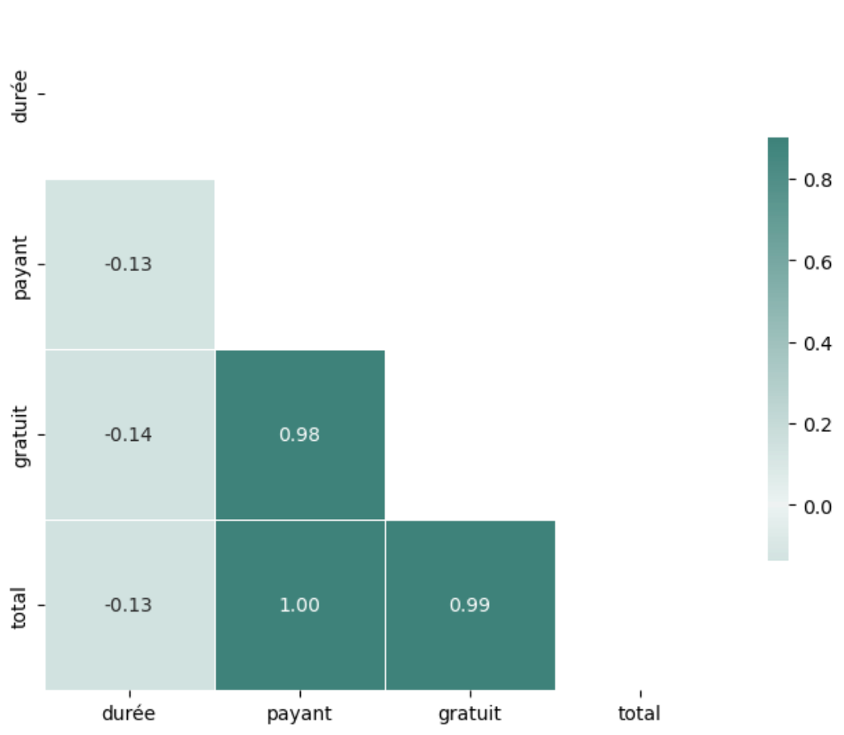
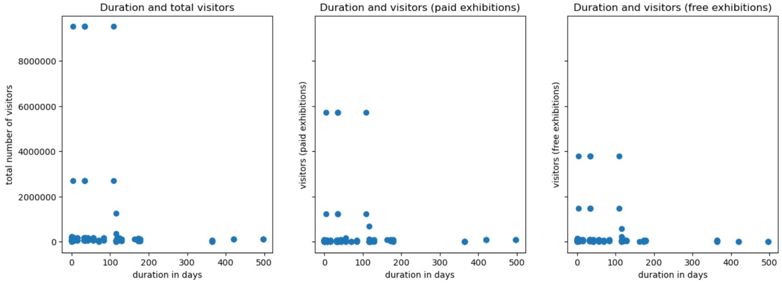
Exhibition’s duration and number of visitors correlation
Scatter plots
Correlation matrix
Notes:
Positive linear correlations between the number of visitors of free exhibitions and of paid exhibitions, as well as between the number of total visitors and the number of visitors for free / paid exhibitions
Linear correlation not obvious between the duration and the number of total visitors, visitors of free exhibitions and paid ones

Slide 15

Tableau Demo

Slide 16
Main results
Weak negative correlation exists between the duration of exhibitions and the number of visitors
The French cities with the highest number of exhibitions visitors between 2001 and 2020 are not necessarily the ones with the most museums
Paid exhibitions generally attract more visitors, but visitors have shown a preference for free exhibitions in Paris since 2005

Slide 17






Machine learning
PCA
n_components = 15
Variance ratio
82,70%
Feature engineering CountVectorizer()
Model training
NearestNeighbors
Data pre-processing
Recommendation generation

Slide 18
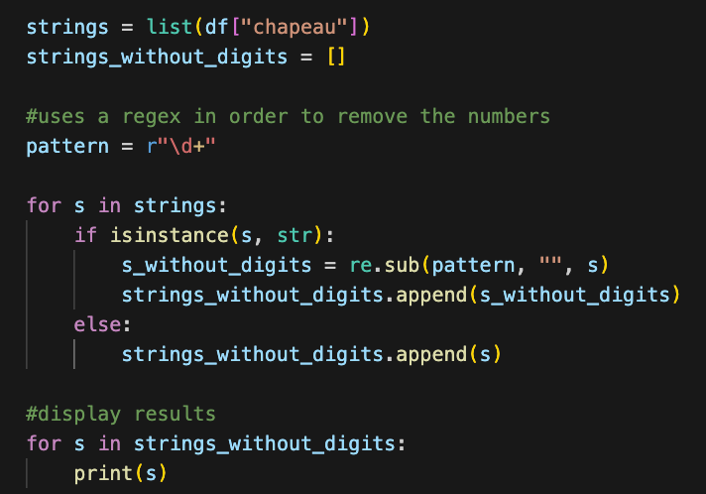
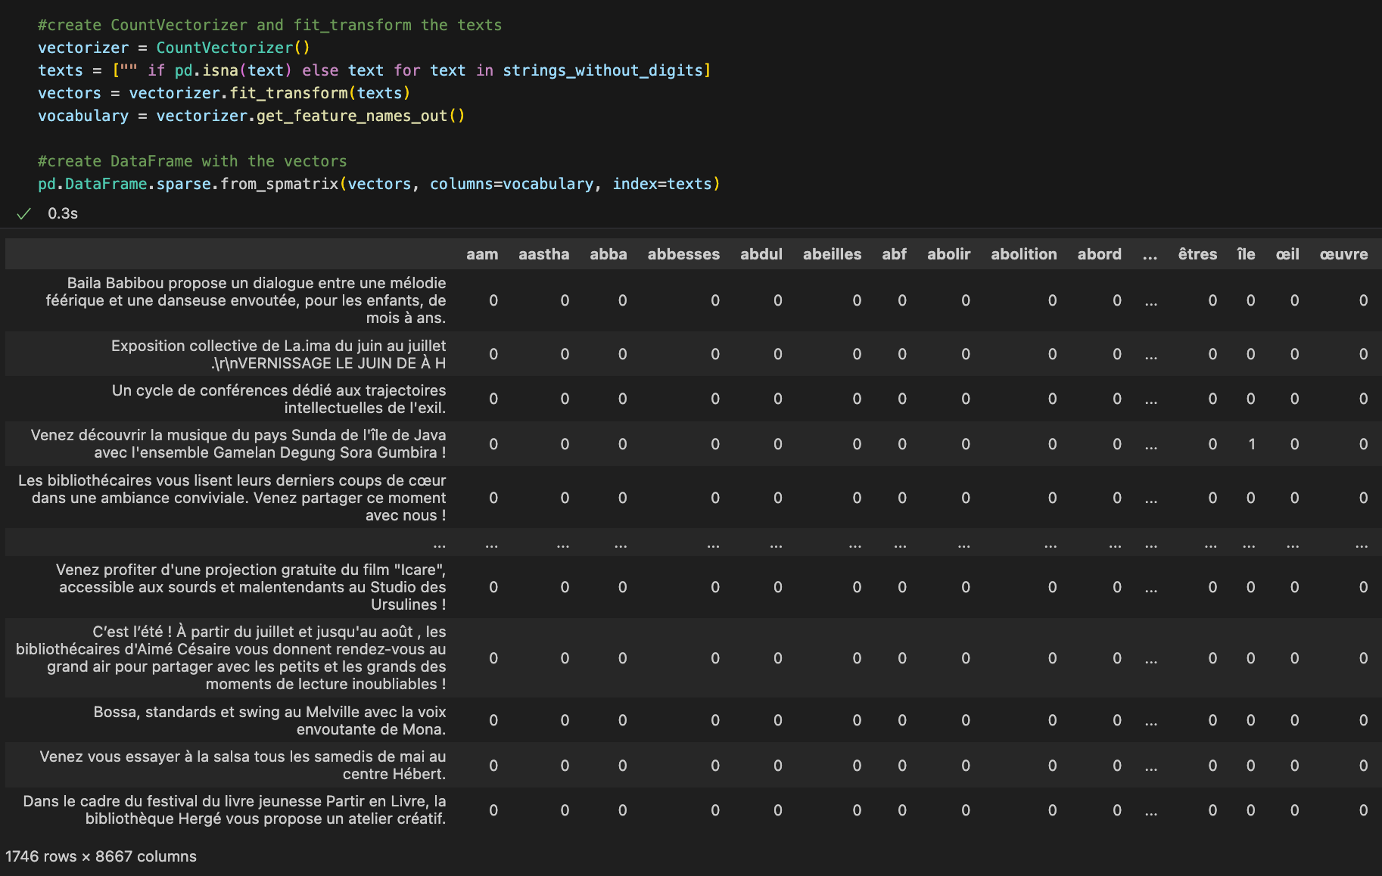
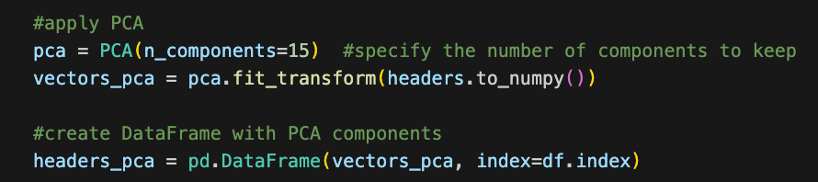
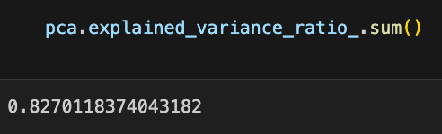
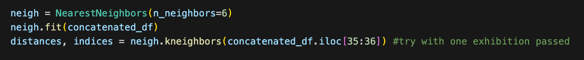
1
2
3
4
5
6

Slide 19
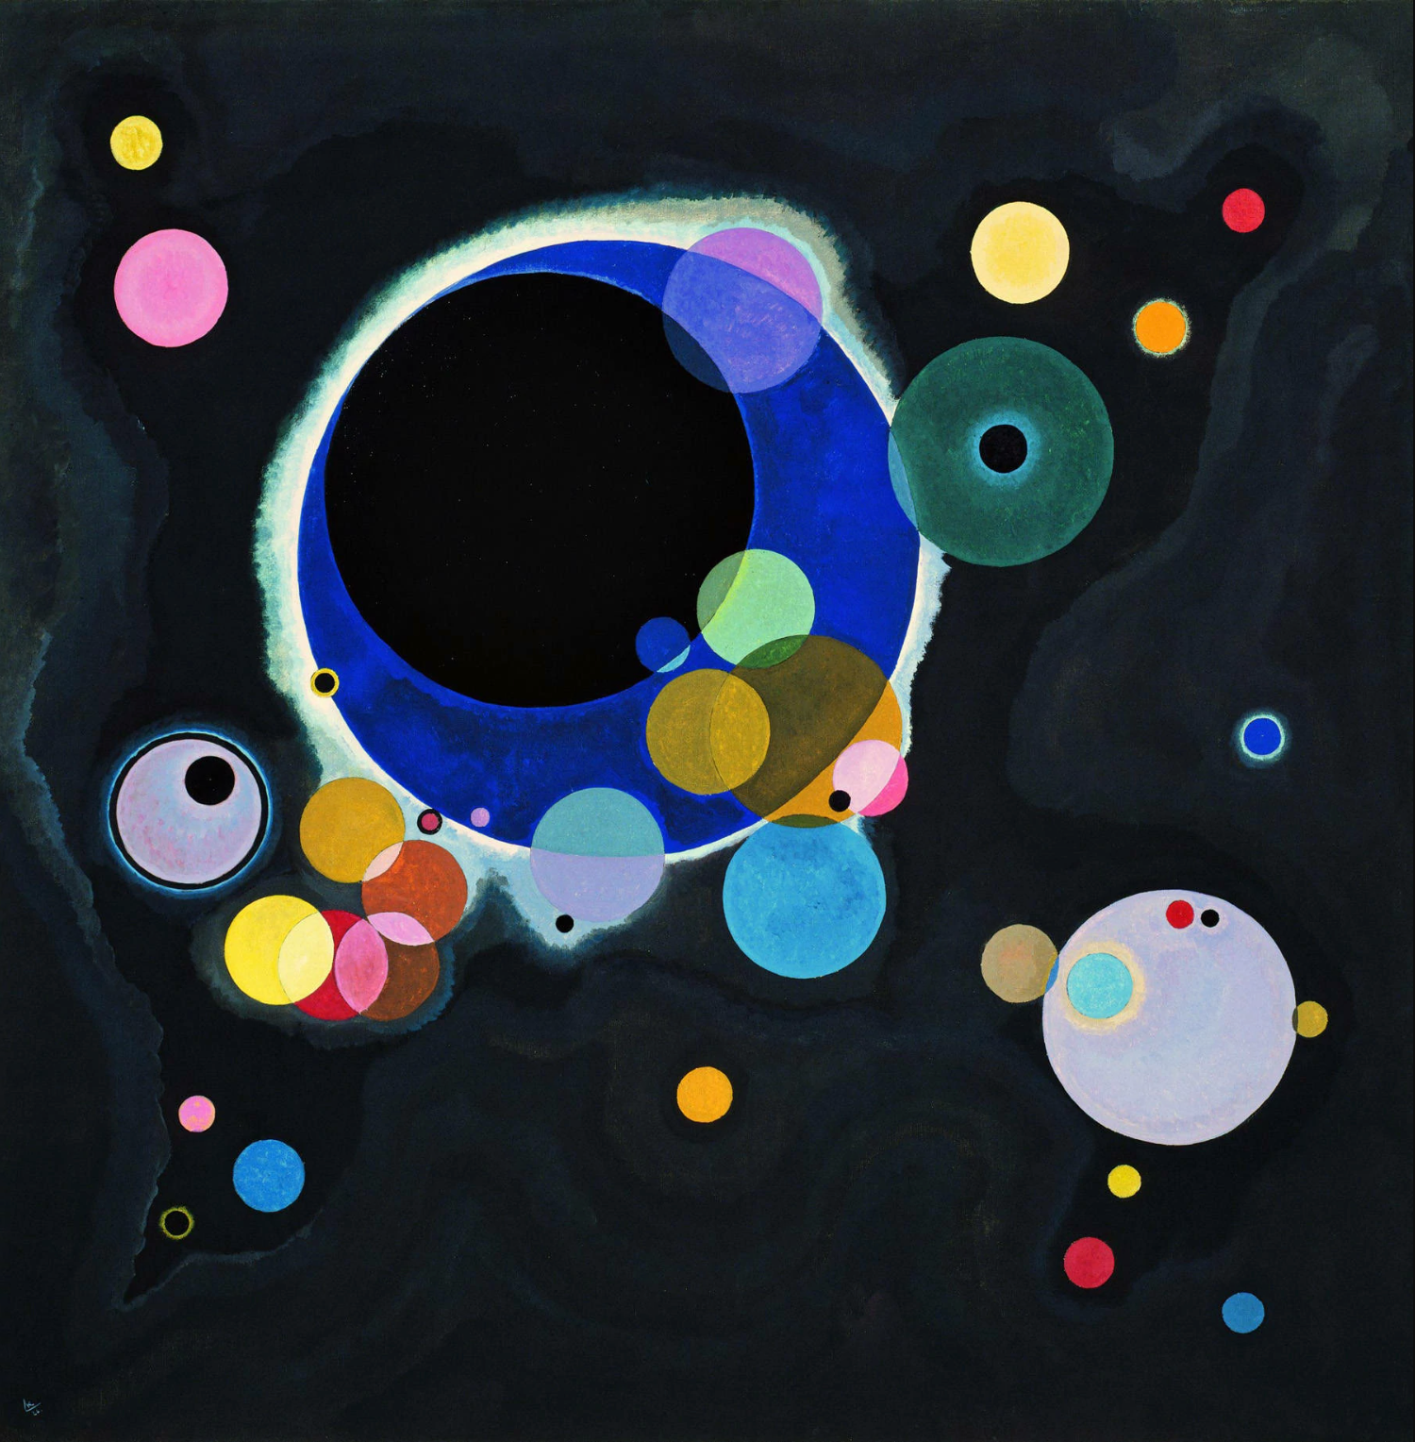
Demo
Streamlit Demo

Slide 20
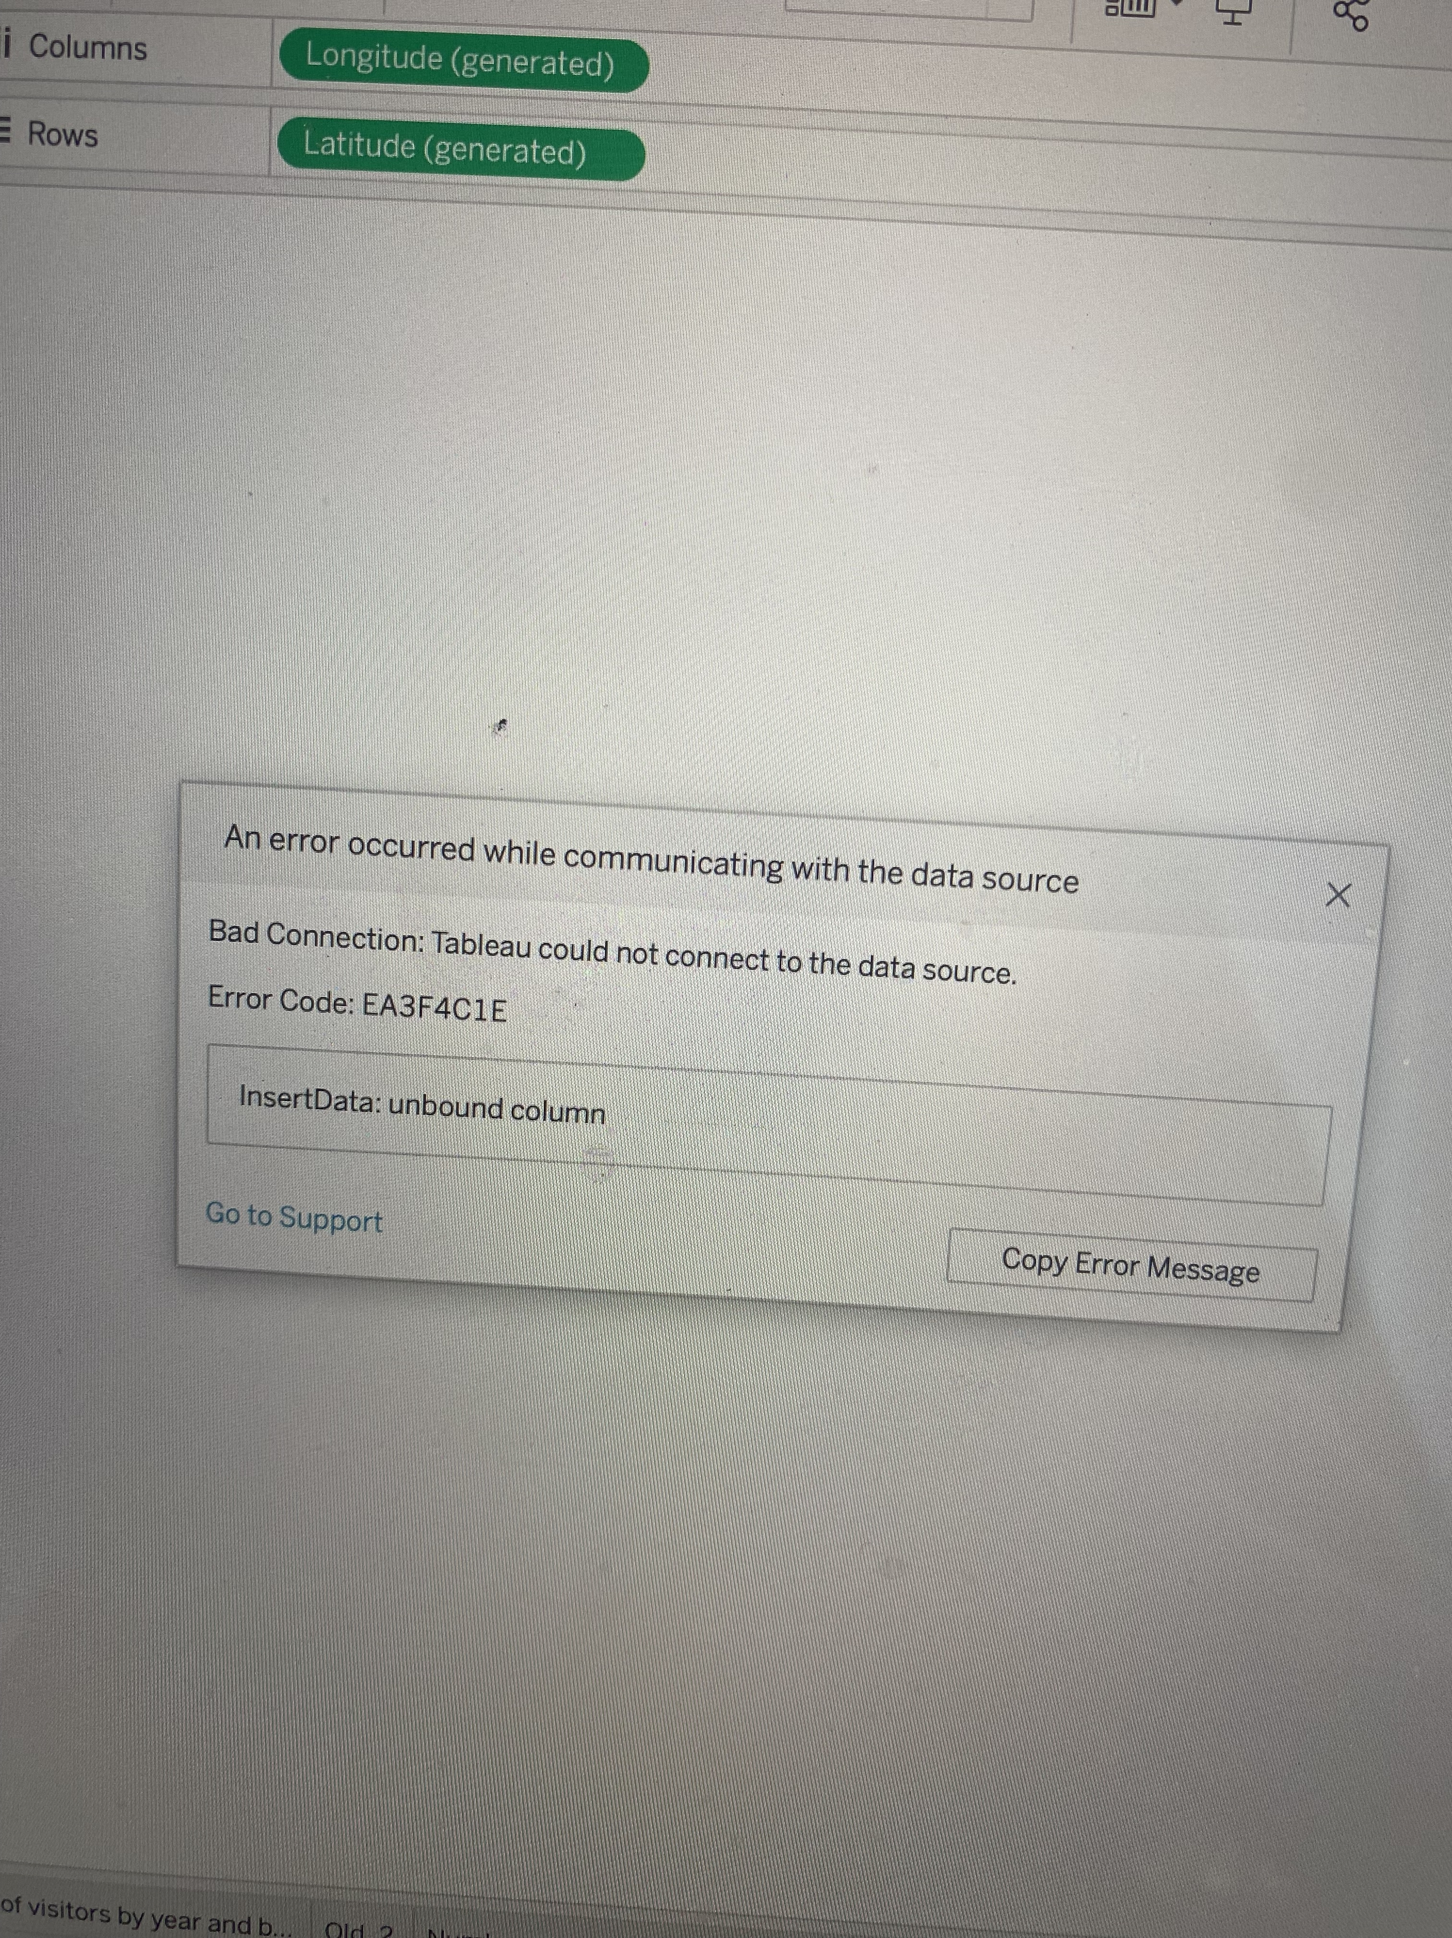
Challenges
Find qualitative data about Paris exhibitions
Panick attack with Tableau Software 🤯
Time management
Wish I had more time for the machine learning model (e.g. TfidTransformer, TruncatedSTD, French stop words)

Slide 21
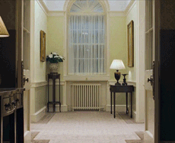
Highlights
Amazing to work on a subject of personal interest
Proud to conduct this end-to-end project
Cherry on the cake 🍒 -> Streamlit web page!

Slide 22

Thank you!

Slide 23
Appendix

Slide 24
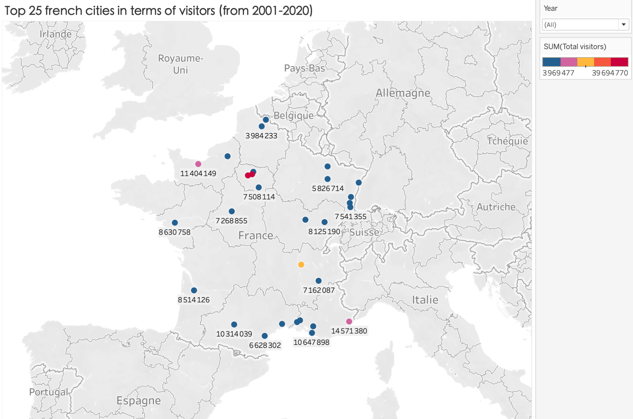

Slide 25
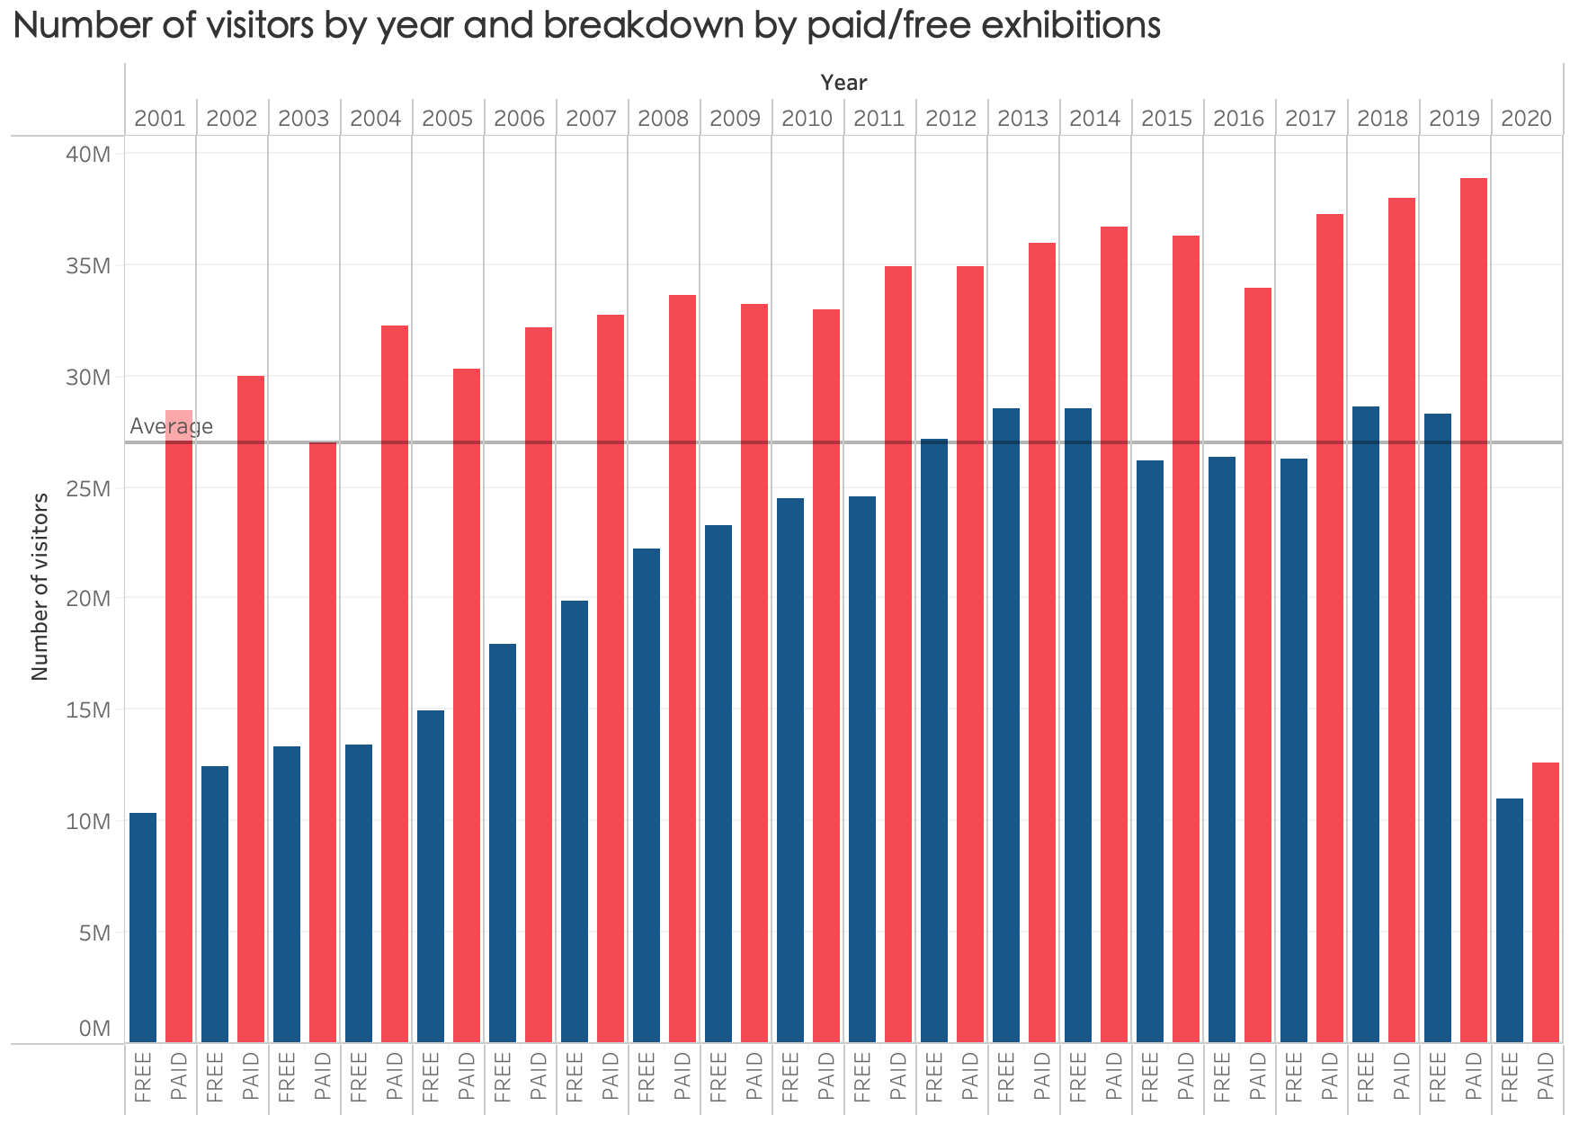

Slide 26
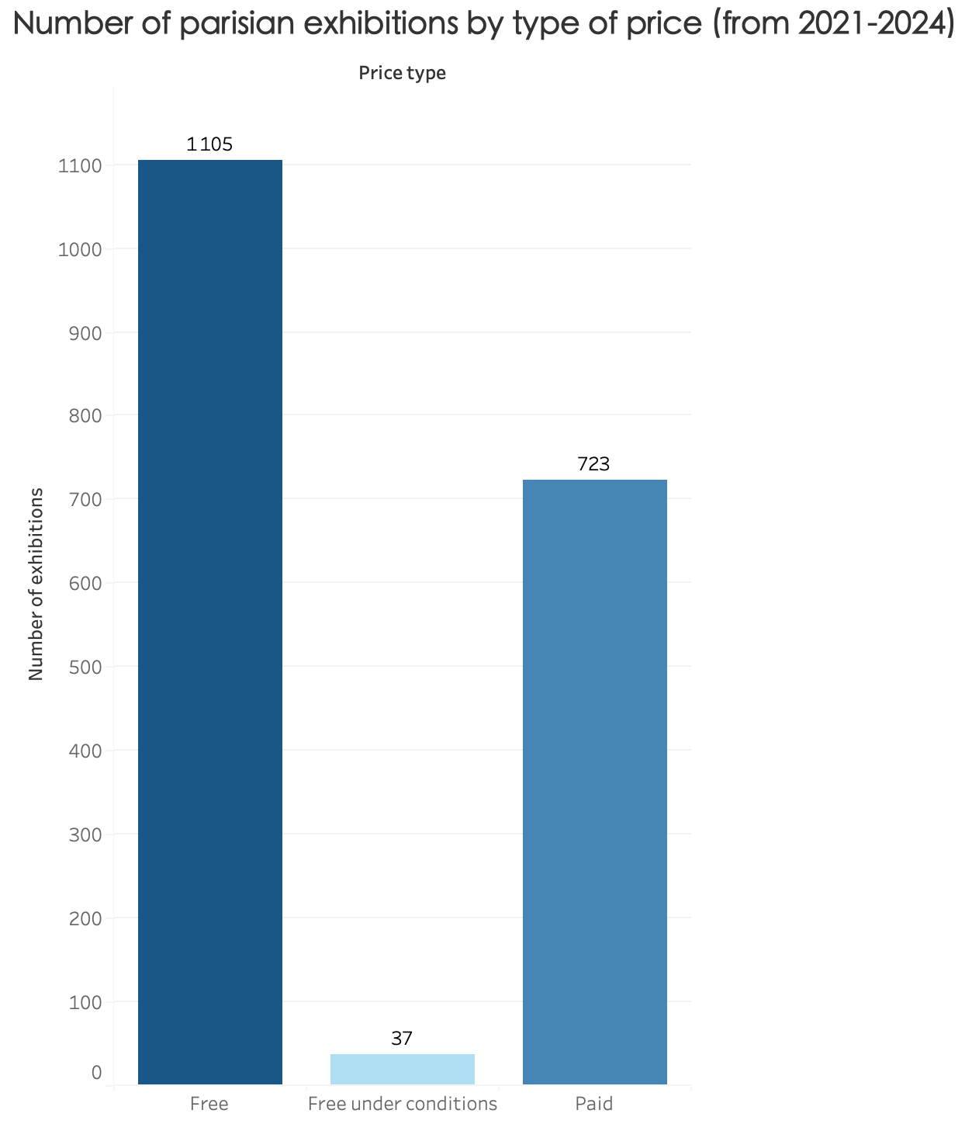

Slide 27
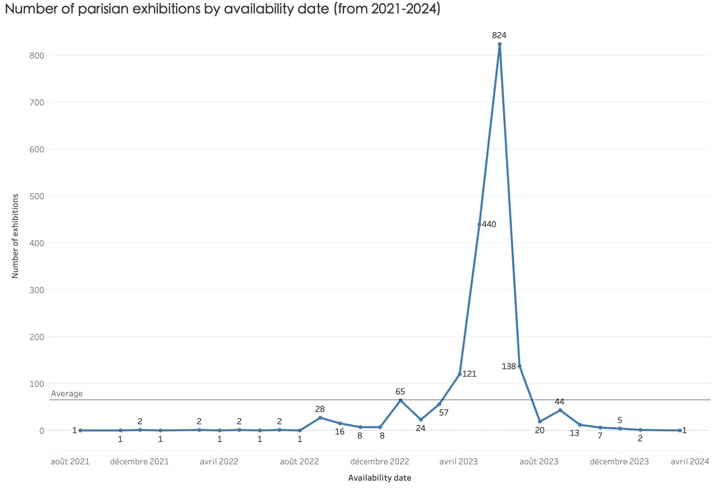

Slide 28
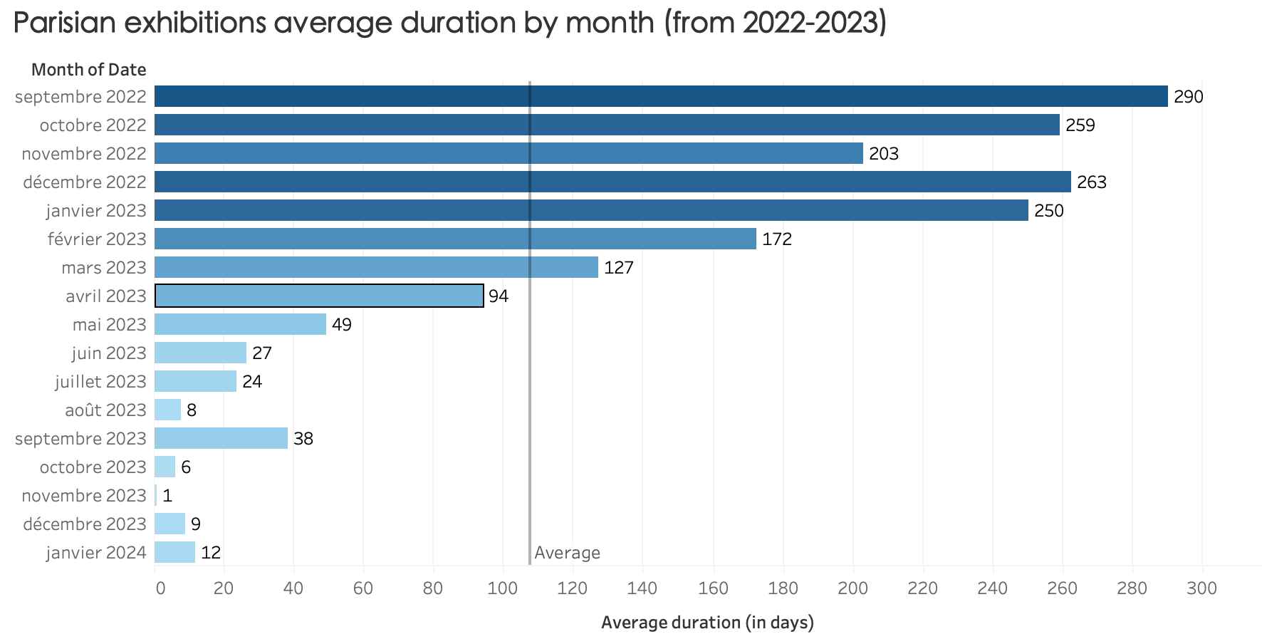

Slide 29
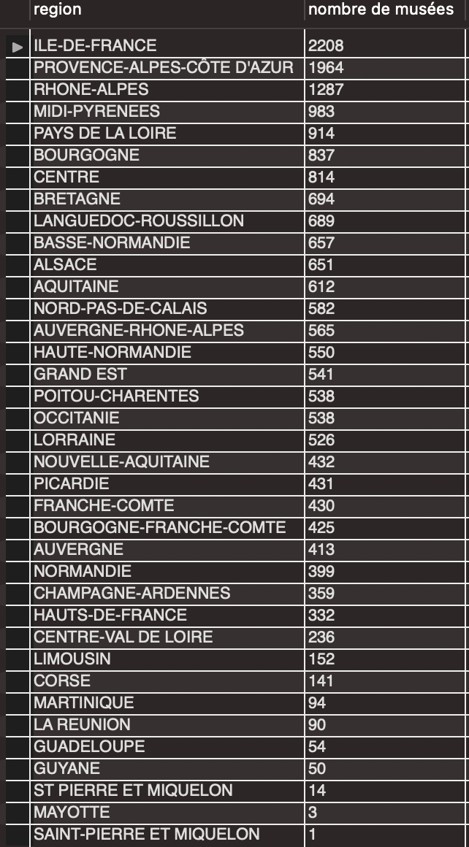
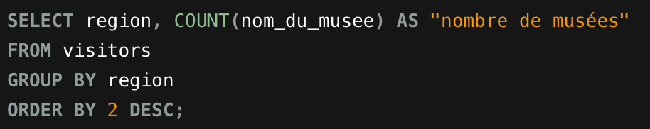
Query #1
Number of museums by region in France

Slide 30
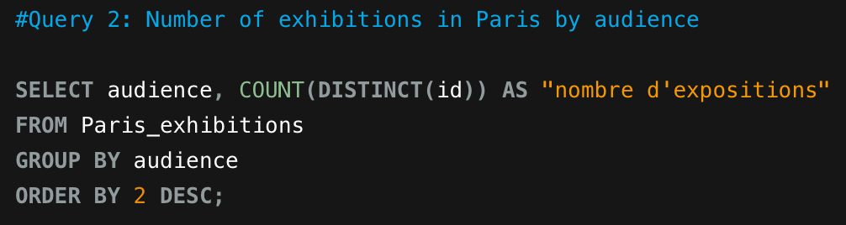
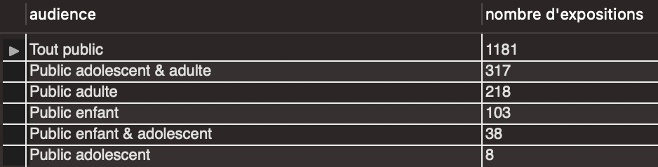
Query #2
Number of exhibitions in Paris and breakdown by audience

Slide 31
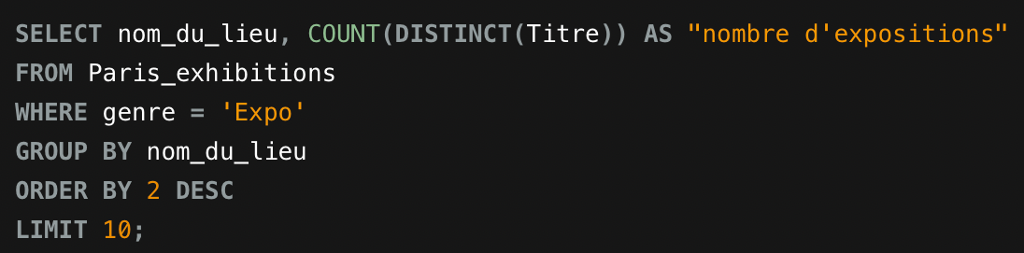
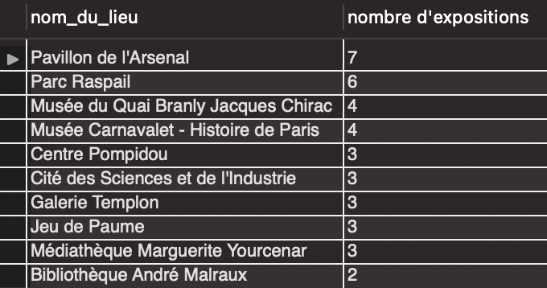
Query #3
Top 10 Parisian museums in terms of exhibitions available

Slide 32
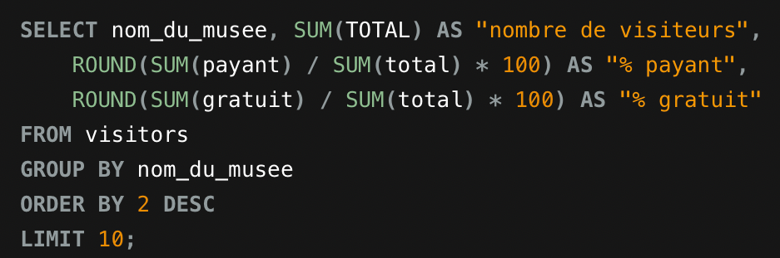
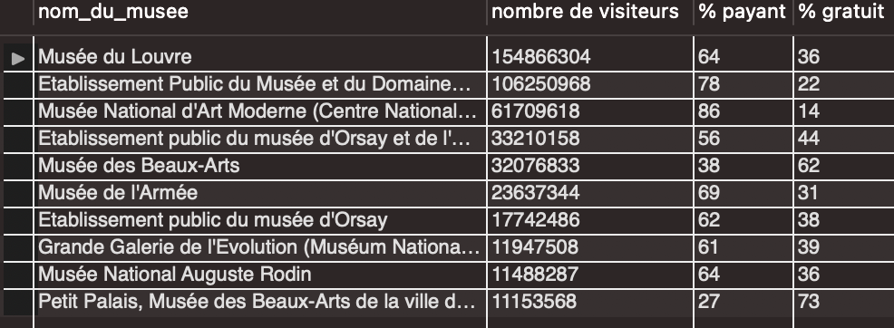
Query #4
Top 10 Parisian museums in terms of visitors and % of paid versus free

Slide 33
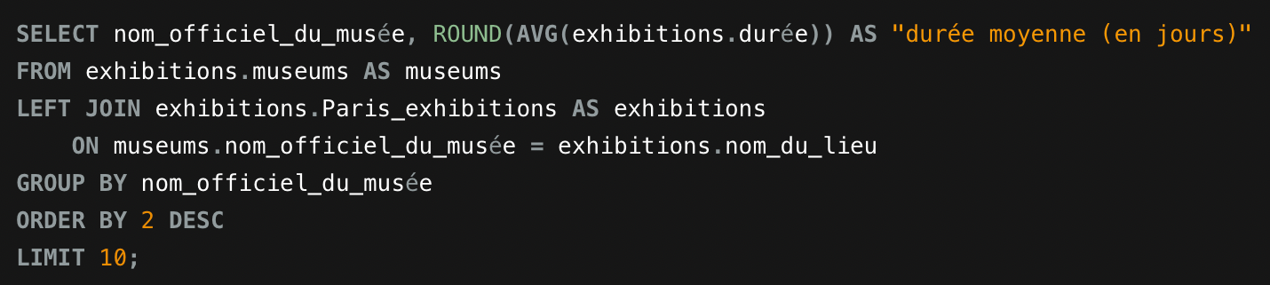
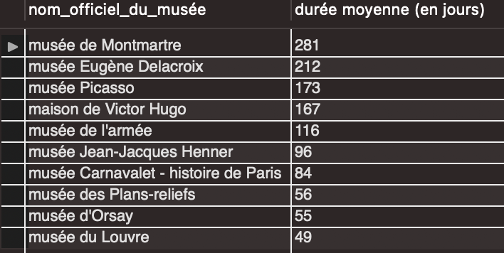
Query #5
Top 10 Parisian museums in terms of exhibitions average duration

